Slide 1

Customer Churn Analysis
Presented By:
Arjun Naluvala

Slide 2
Agenda
Business Problem
Project Overview
Data Preparation
Dashboard Visualizations
Applications
Recommendations
Challenges
Conclusion

Slide 3
BUSINESS PROBLEM
The telecom company is facing increasing customer churn, which leads to revenue loss and reduced customer lifetime value.
The company lacks a clear understanding of why customers are leaving and which customer segments are at high risk of churn.
This project analyzes customer churn using demographics, services, contracts, and billing data and provides data-driven solutions.

Slide 4
Project Overview
The main objectives of this project are:
Analyse customer churn using Power BI.
It involves data cleaning and visualization to generate meaningful insights.
Identify key reasons for customer churn
Study customer behavior using demographics & service/billing data.
Track churn by contract type, services & payment methods
Monitor business KPIs
Spot high-risk customers & apply retention strategies to boost revenue

Slide 5
Project Description
The dataset contains unique customer identification and basic details like gender and senior citizen status.
It includes information about customer relationships such as partner and dependents.
It provides details on services like phone service, internet service, and additional features.
Billing details such as contract type, payment method, monthly charges, and total charges are included.
The churn column indicates whether the customer has stayed or left the service.

Slide 6
Data Preparation
Imported dataset into Power BI
Removed duplicate records to ensure data accuracy
Handled missing values
Fixed nulls and converted Total Charges to numeric
Created DAX for Churn Rate, Avg Charges, Avg Tenure, Revenue
Ensured dataset is clean, consistent, and ready for analysis

Slide 7
Dashboard Visualizations
Customer Demographics Analysis
Visuals Used:
KPI Cards -> Total Customers, Churned Customers, Churn Rate, Average Monthly Charges, Average Tenure
Donut Chart -> Customer Distribution by Gender
Bar Chart -> Tenure Group vs Customer Count
Column Chart -> Churn Rate by Tenure
Line Chart -> Tenure vs Average Monthly Charges
Line Chart (with legend) -> Average Monthly Charges by Tenure and Gender
Stacked Bar Chart -> Senior Citizen vs Churn
Slicers -> Contract Type, Gender

Slide 8
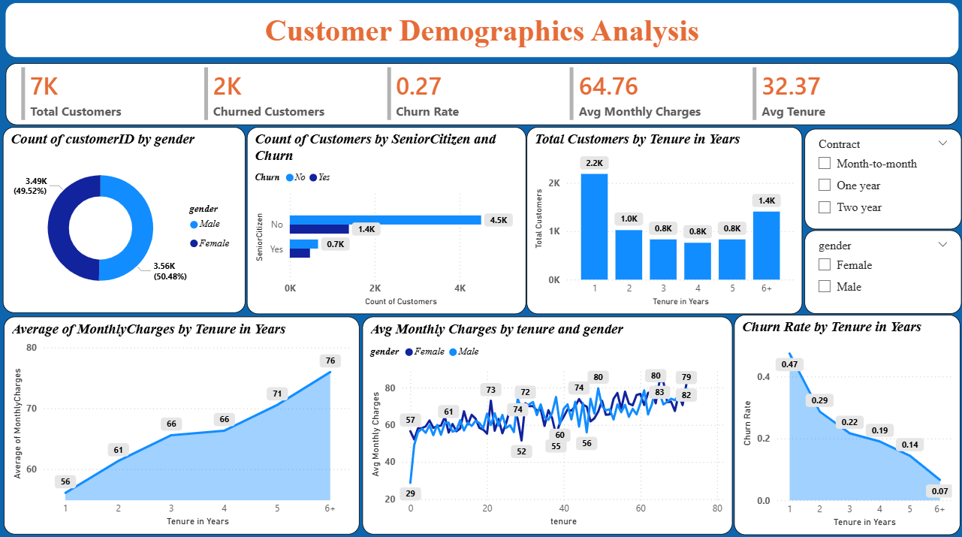

Slide 9
Key Insights
Male and female customers are almost equally distributed.
Senior citizens show slightly higher churn than non-senior customers.
Most customers belong to lower tenure groups (1–2 years).
Churn rate decreases as tenure increases (highest for new customers).
Average monthly charges increase gradually with tenure.

Slide 10
Service Subscription Analysis
Visuals Used:
KPI Cards -> Churned Customers, Churn Rate, Streaming Movies Churn, Streaming TV Churn
Bar Chart -> Customers by Phone Service
Clustered Column Chart -> Internet Service vs Churn
Donut Chart -> Customer Distribution by Internet Service
Bar Chart -> Add-on Services Used by Churned Customers
Line and Clustered Column Chart -> Total Customers & Churn Rate by Total Service Count
Slicers -> Internet Service, Contract, Gender, Device Protection, Senior Citizen

Slide 11
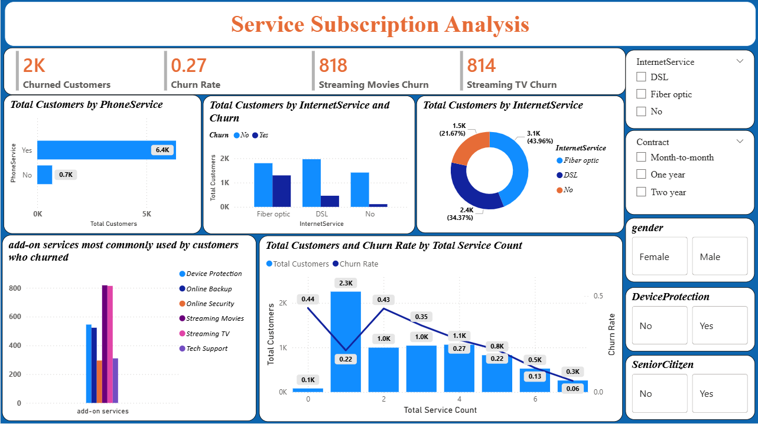

Slide 12
Key Insights
Most customers have phone service; very few without it.
Fiber optic internet users form the largest customer group.
Customers with fewer services churn more
Churn rate decreases as total service count increases.
Add-on services like streaming and device protection are common among churned customers.

Slide 13
Contract & Billing Insights
Visuals Used:
KPI Cards -> Total Customers, Churned Customers, Churn Rate, Average Monthly Charges, Average Total Charges
Stacked Bar Chart -> Average Tenure Distribution by Contract Type
Clustered Column Chart → Average of Total Charges by Contract and Churn
Clustered Column Chart → Total Customers by Payment Method and Churn
Clustered Column Chart -> Churn Rate by Contract
Slicers -> Contract Type, Payment Method

Slide 14
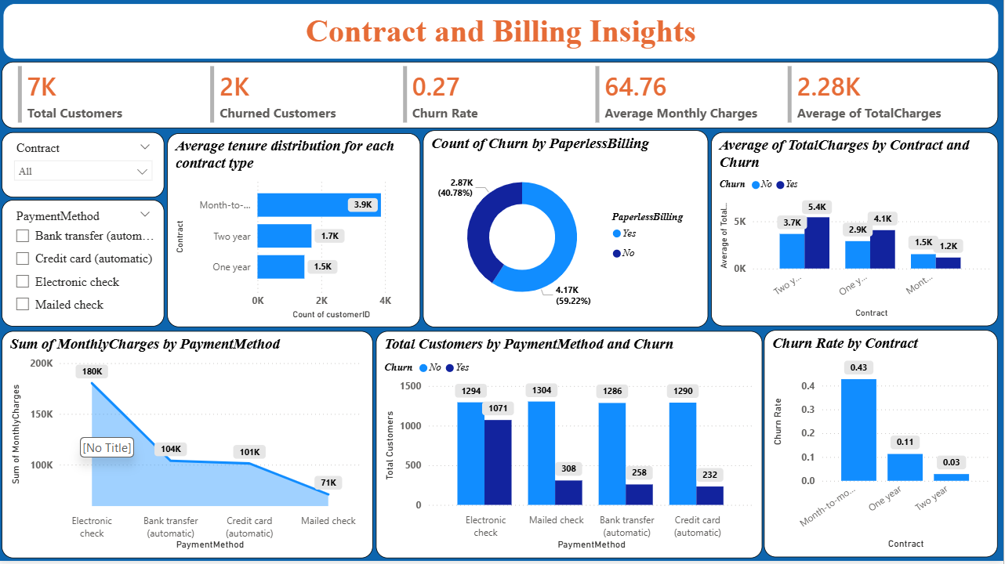

Slide 15
Key Insights
Electronic check is the most commonly used payment method.
Customers using electronic check show higher churn compared to other payment modes.
Automatic payment methods (bank transfer / credit card) have lower churn.
Month-to-month contracts have the highest churn rate.
One-year and two-year contracts significantly reduce churn.
Longer contract duration improves customer retention.

Slide 16
Churn Prediction & Key Drivers
Visuals Used:
KPI Cards -> Churn Rate, Retained Revenue, Lost Revenue
Gauge Chart -> Churn Rate Indicator
Donut Chart -> Revenue by Churn
Tree map -> Churned Customers by Contract
Bar Chart -> Total Revenue by Churn
Bar Chart -> Churn Rate by Contract
100% Stacked Bar Chart -> Customers by Contract and Churn

Slide 17
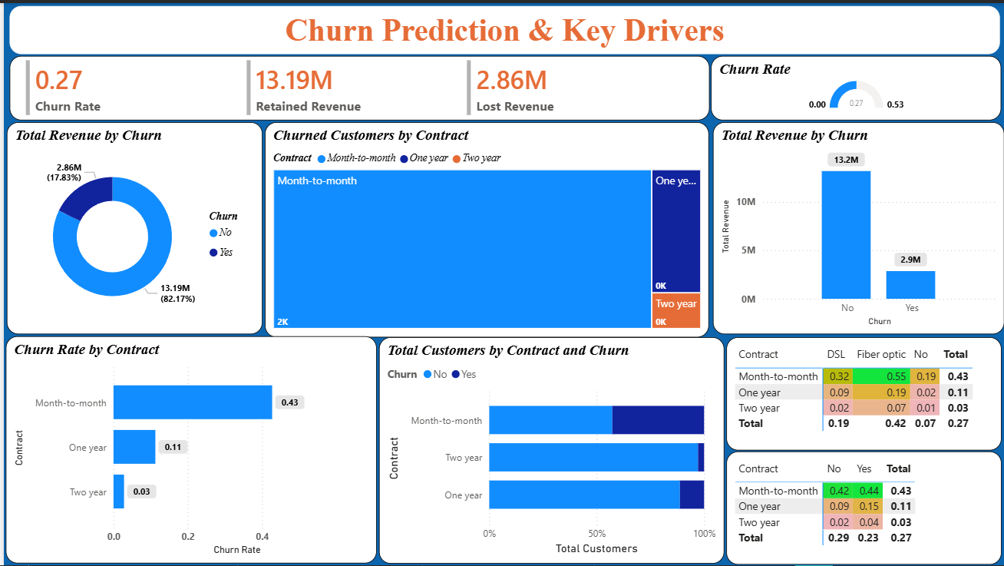

Slide 18
Key Insights
Overall churn rate is around 27%.
Retained revenue (13.19M) is much higher than lost revenue (2.86M).
Month-to-month contracts contribute the highest churn.
Two-year contracts show the lowest churn rate.
Churn rate decreases as contract duration increases.
Fiber optic customers have higher churn compared to DSL and no internet.
Most churned customers belong to month-to-month contracts.
Non-churned customers generate the majority of total revenue.

Slide 19
Applications
Helps support teams improve service for churn-prone users.
Enables management to track churn KPIs.
Guides product teams in pricing and bundling decisions.
Assists marketing teams in targeted retention campaigns.
Supports business planning with revenue risk insights.

Slide 20
Recommendations
Encourage long-term contracts (one-year / two-year).
Promote automatic payment methods to reduce churn.
Offer discounts for customers with fewer services.
Target fiber optic users with retention campaigns.
Provide loyalty benefits for long-tenure customers.

Slide 21
Conclusion
Reveals key churn patterns and drivers.
High charges & month-to-month plans show highest churn.
Churn is highest among month-to-month customers with fewer services.
Longer contracts and bundled services improve retention.
Using these insights helps reduce churn and increase revenue.

Slide 22

THANK YOU

